Slide 1
TEMPERATURE
Content:
12.1 Thermal equilibrium
12.2 temperature scales
12.3 Practical thermometers
TOPIC 12

Slide 2
What is Temperature?
Temperature: fundamental quantity that measures the degree of hotness of a body as indicated on the calibrated scales
Temperature is the property of an object that determines which way heat will flow between it and another object
Example: An ice cube in your hand feels cold because the heat transfer from your hand to the cube.
Heat is the energy that flows from one body to another because of a temperature difference between them.

Slide 3
Thermal Equilibrium
If 2 bodies, A and B initially at different temperatures T1 & T2 are placed in thermal contact, heat flows from the higher to the lower temperature body, until the temperature equalizes.
When there is no further transfer of heat, the bodies are said to be in thermal equilibrium.
In other words,
- There is no net energy exchange between the 2 systems
- Their temperature are identical
- They have achieved a steady state condition

Slide 4
Measuring Temperature
We need an instrument called thermometer to measure temperature accurately.
To do this, the thermometer make use of the thermometric property (the physical property that changes with temperature) of a substance.
Thermometric property characteristics:
- Must vary continuously with the degree of hotness
- Can be measured accurately
- Should vary over a wide range of temperature
- Must not change its state as temperature change
- Temperature is reproducible

Slide 5
Thermometric properties
Thermometric property | Thermometer type
Volume of a fixed mass of liquid. | Liquid in glass thermometer
Resistance | Platinum-resistance thermometer
Pressure for a fixed mass of gas at constant volume | Constant-volume gas thermometer
E.m.f / Voltage | Thermocouple

Slide 6
Establishing a Temperature scale
To construct a temperature scale, you need to take the following steps:
Step 1:
Choose a substance that has one of the thermometric property listed in previous table.
Step 2:
Choose 2 standard degrees of hotness which are easily obtainable and reproducible. We refer them as fixed points. It is very common to choose the pure melting point of ice (0°C) and steam as fixed points (100°C).
Step 3:
Divide the temperature range between the two fixed points into a number of equal parts. For example, in the Centigrade scale, there are 100 equal marks or degrees between these 2 fixed points.

Slide 7
The Centigrade Scale
A scale which is based on experiment uses two fixed points.
The 2 most common fixed point are the melting point of pure ice (0°C) & boiling point of water (100°C)
Determination of ice point | Determination of steam point
Immerse bulb & lower stem of thermometer into the funnel of shaved ice. When mercury level in stem is steady after some time, a mark is made at that point of the stem. This mark correspond to ice point and is assigned 0 °C | Place thermometer right above the boiling water. Its stem should protrude above the top of apparatus. When mercury level in stem is steady after some time, a mark is made at that point of the stem. This mark correspond to ice point and is assigned 100 °C
ice
steam
Heat supply

Slide 8
Calculating Temperature on a Centigrade scale
In a mercury thermometer, the physical property that changes is the volume of a fixed mass of mercury.
But instead of measuring volume change, we can measure the change in the length of a mercury thread since the cross sectional area of the thread is uniform.
If the liquid levels above the bulb of the thermometer is L₀ when bulb is immersed in pure melting ice, L₁₀₀ when immersed in steam, and L_{θ} when immersed in an unknown body whose temperature θ is to be determined, then the value of θ can be easily calculated using simple proportion since the physical property is assumed to be directly proportional to temperature, θ.

Slide 9
Calculating Temperature on a Centigrade scale
Thermometric property
L₁₀₀
L_{θ}
L₀
Temperature, (˚C)
0
θ
100
Property of L should varies linearly with temperature, then,
(θ – 0) = (L_{θ} – L₀)
(100 - 0) (L₁₀₀ – L₀)

Slide 10
Calculating Temperature on a Centigrade scale
Generally all other thermometric properties vary uniformly with temperature, thus we can write a general equation for the centigrade scale as:
(θ – 0) = (X_{θ} – X₀)
(100 - 0) (X₁₀₀ – X₀)
Thermometric property
X₁₀₀
X_{θ}
X₀
Temperature, (˚C)
0
θ
100

Slide 11
Example 1
In an unmarked mercury thermometer, it was found experimentally that the length L₀ was 5 cm and the length L₁₀₀ was 25 cm. What is the temperature when L_{θ} is (i) 14 cm (ii) 3 cm?

Slide 12
Example 2
A mercury thermometer is found to have a volume of 0.400 cm³ at 0˚C and a volume of 0.425cm³ at 100˚C. What is the temperature on the Celsius scale when the volume of mercury is 0.420 cm³?
A piece of metal wire has a resistance of 800 Ω at the ice point and 810 Ω at steam point. Calculate the room temperature if the resistance of this wire is 803 Ω

Slide 13
Types of Thermometers
Thermometric property | Thermometer type
Volume of a fixed mass of liquid. | Liquid in glass thermometer
Resistance | Platinum-resistance thermometer
Pressure for a fixed mass of gas at constant volume | Constant-volume gas thermometer
E.m.f / Voltage | Thermocouple

Slide 14

Liquid-in-glass-thermometer
Normally used mercury, the wall of mercury filled glass bulb is made thin to allow heat to penetrate through the glass wall and reduces the response time for thermometer. Thermometric property/parameter is the length of mercury.
The thin-wall glass bulb is to allow conduction of heat quickly through the glass to the liquid.
Bore capillary is narrow to increase the sensitivity of the thermometer.
Walls of the long tube is thick to prevent heat transfer to environment.
Defining equation is:
θ = ( L_{θ} – L₀ ) x 100°C
( L₁₀₀ – L₀ )

Slide 15
Liquid-in-glass-thermometer
MERCURY IN GLASS THERMOMETER | ALCOHOL IN GLASS THERMOMETER
Advantages - It is a good conductor of heat and therefore the whole liquid reaches the temperature of the surroundings quickly. - It does not wet (cling to the sides of) the tube. - It has a high boiling point (357°C) - It has a visible meniscus. | Advantages - It has a low freezing point (-115 °C) therefore it is very suitable for place where the temperature gets very low. - It is an easily available cheap liquid, which is safe to use/not poisonous
Disadvantages - Mercury is very poisonous. - it is expensive - It has a high freezing point (- 39°C) therefore it cannot be used in places where the temperature gets very low. | Disadvantages - it wets the tube - it has a low boiling point (78°C) cannot be used in places with high temperatures - it does not react quickly to changes in temperature. (less sensitive) - It needs to be dyed, since it's colourless.

Slide 16
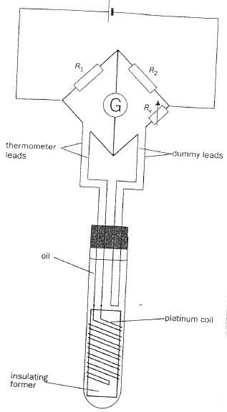
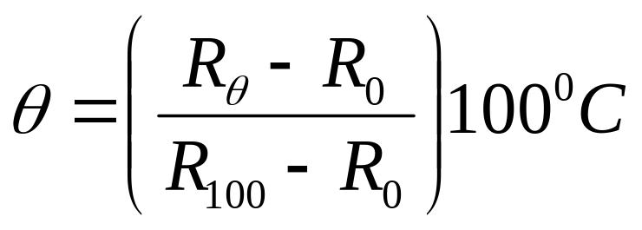
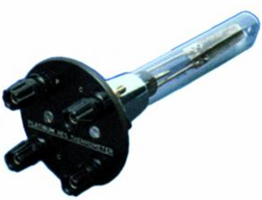
Platinum-Resistance thermometer
Thermometric property is the change in resistance of a wire as temperature changes.
It consists of a length of fine coiled wire wrapped around a ceramic or glass core. The element is usually quite fragile, so it is often placed inside a sheathed probe to protect it.
The thermometer itself is usually a coil of
pure platinum wire of diameter about 0.1mm and resistance about 25 ohm.
These thermometer are used in industry to measure fluid or gas temperatures in pipes and tanks.

Slide 17
Example 3
The resistance of a platinum wire is 3.129 Ω at the ice-point and 4.620 Ω at the steam point. It is used to measure an unknown temperature θ and its resistance is 3.547 Ω. What is the unknown temperature θ on the centigrade scale of this thermometer?
A platinum resistance thermometer is 3.50 Ω at ice point, 4.80 Ω at steam point, and R at -10˚C. Find R.

Slide 18
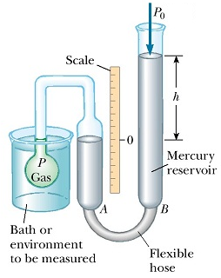
Constant volume gas thermometer
Thermometric property/parameter is pressure of a fixed mass of gas at constant volume.
Bulb is placed in the fluid whose temperature is being measured.
An increase in temperature causes the pressure of the gas to increase and push the mercury down in tube A and up in tube B.
Height of tube B is adjusted so as to bring the mercury level back to its original position at the reference mark at 0.
After adjusting, we would obtain a new height, h.
This means that the gas volume has been restored
to its original value.
The gas pressure is equal to the atmosphere
pressure + pressure due to difference in height
of mercury in tubes A & B.
Defining equation is:
θ = ( P_{θ} – P₀ ) x 100°C
( P₁₀₀ – P₀ )

Slide 19
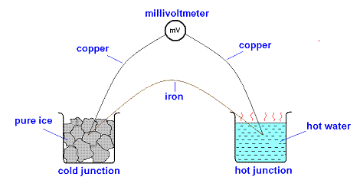

Thermocouple
Thermometric property/parameter is the change in emf in the thermocouple as temperature change.
Thermocouple is set up by using copper and constantan/iron wires twisted firmly together at the 2 junctions. (nickel-chromium / nickel-aluminium)
When these 2 junctions are set in different temperatures, a measureable emf will be set up. This emf depends on the temperature difference between the 2 junctions. Greater temperature difference, greater the emf will be.
In practice, 1 junction is kept at ice point and another is used as the temperature probe.

Slide 20
Example 4
A certain thermocouple, when one junction is at 0˚C and other junction at 100˚C, gives an emf reading of 0.52mV.
a.) The second junction when placed in a certain vapor, records an emf reading of 1.5mV. What is this temperature?
b.) The second junction when placed in a certain vapor, records an emf reading of -2.0mV. What is this temperature?

Slide 21
Example 5
When one junction X of a thermocouple is placed in melting ice at 273K and the other junction Y in steam at 373K, the emf is 8.2 mV.
Junction X is removed from the ice, and placed in a liquid bath, while Y remains in steam. The emf is now 12.3 mV in the same direction. Find the temperature of the liquid bath.

Slide 22
Example 6
When a thermocouple has one junction in melting ice and the other junction in boiling water it produces an emf of 63 µV.
a.) What emf would be produced if the second junction was also placed in melting ice?
b.) When the second junction is placed in a cup of coffee, the emf produced is 49 µV.
Calculate the temperature of the coffee.
c.) The second junction is now placed in a beaker of melting lead at 327 °C.
i.) Calculate the emf which would be produced.
ii.) State the assumption you make.

Slide 23
Types of thermometer | Thermometric property | Advantages | Disadvantages
Mercury-in-glass (-39 to 500 °C) | Length of mercury column | Cheap Portable Direct reading Convenient | Limited range Fragile Slow response Not very accurate Fluid may be toxic
Resistance thermometer (-200 to 1200 °C) | Electrical resistance of a platinum coil | Wide range Accurate Sensitive to small change in temperature | Bulky when use with Wheatstone bridge Not suitable for rapid varying temperature

Slide 24
Types of thermometer | Thermometric property | Advantages | Disadvantages
Constant Volume Gas (-270 to 1500 °C) | Pressure of a fixed mass of gas at constant volume | Wide range Most accurate Sensitive to small change in temperature | Bulky Not suitable for rapid varying temperature
Thermocouple (-250 to 1500 °C) | Emf across the junction of two dissimilar metals | Sensitive to rapid change in temperature Wide range Readings can be stored into microcomputer Cheap and easily constructed | Emf produced is small (mV), sensitive electrical equipment has to be used to ensure accurate measurement

Slide 25
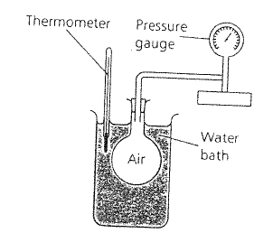
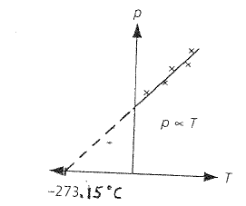
The Thermodynamic Scale
Thermometers based on different thermometric properties will give different values for the same temperature, except at fixed points. This arises because the properties do not actually vary linearly as assumed.
Lord Kelvin in 1848 proposed the absolute scale of temperature on the basis of the existence of an absolute zero and the relationship between the pressure and temperature of an ideal gas.
It is also known as Kelvin / absolute / ideal gas scale. (measured in K)

Slide 26
The Thermodynamic Scale
The 2 fixed points for Kelvin scale are at:
1.) absolute zero ( 0 K)
2.) triple point of water* (273.16 K or 0.01°C)
* Triple point of water is a single combination of pressure and temperature at
which liquid water, solid ice, and water vapour can coexist in a stable
equilibrium occurs at exactly 273.16 K (0.01 °C) and a vapour pressure of
611.73 Pa.
Defining equation is:
(T_{T} – T_{0 K}) = (P_{T} – P_{0 K}) ; T_{T} = ( P_{T} ) x ( T_{Tr} )
(T_{Tr} – T_{0 K}) (P_{Tr} – P_{0 K}) ( P_{Tr} )
P₀ = this is not the pressure at zero degree BUT pressure at zero Kelvin
When T = 0 K, P₀ = 0 Pa

Slide 27
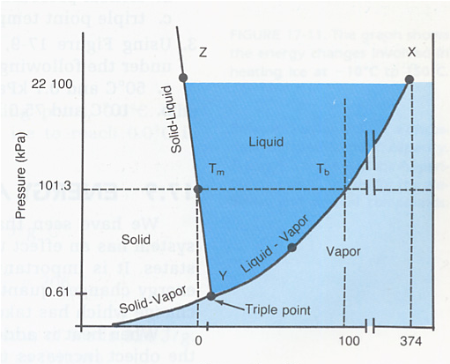

Phase Diagram of Water

Slide 28
Example 7
The pressure recorded by a calibrated volume gas thermometer at a Kelvin temperature T is 4.80 x 10⁴ Nm⁻². Calculate T (in Kelvin) when the pressure at the triple point, 0.01°C is 4.20 x 10⁴ Nm⁻².
At the triple point of water the pressure of a fixed mass of gas is 2680 Pa. The temperature is changed to T while the volume of the gas is kept constant. The pressure is then 4870 Pa. Find the value of T.

Slide 29
Relationship between Celsius & Kelvin scale
The Celsius scale of temperature is merely an arithmetical adjustment to the thermodynamic scale measured in Kelvin.
The temperature in Celsius , θ (°C) is given by subtracting 273.15 from the thermodynamic temperature, T (K)
θ (˚C) = T (K) - 273.15

Slide 30
Example 8
What is 273.00 K on the Celsius scale of temperature?
What thermodynamic temperature is equivalent to 501.85 ˚C
A kettle containing water at 30 °C is heated to 100 °C. Find the change in temperature in (i) °C, (ii) K.

